Slide 1
The night sky
Year 7 Science

Slide 2

Review
1. List these objects from largest to smallest:
terrestrial planet
moon
asteroid
star
comet
gas planet
galaxy
2. Choose two of these objects to compare and contrast

Slide 3
Learning Intentions
Predictable phenomena on Earth, including seasons and eclipses, are caused by the relative positions of the Sun, Earth and the Moon.

Slide 4
Success criteria
Identify objects in the night sky
Define and give examples of constellations.
Use a planisphere.

Slide 5
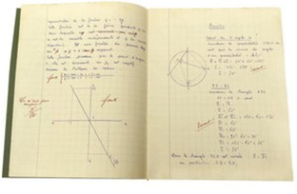
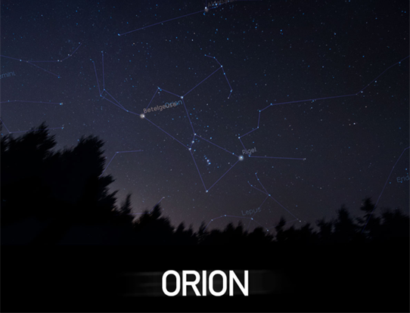
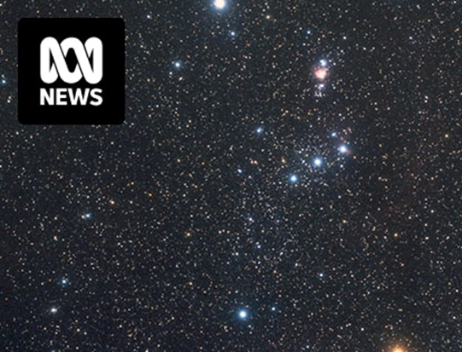
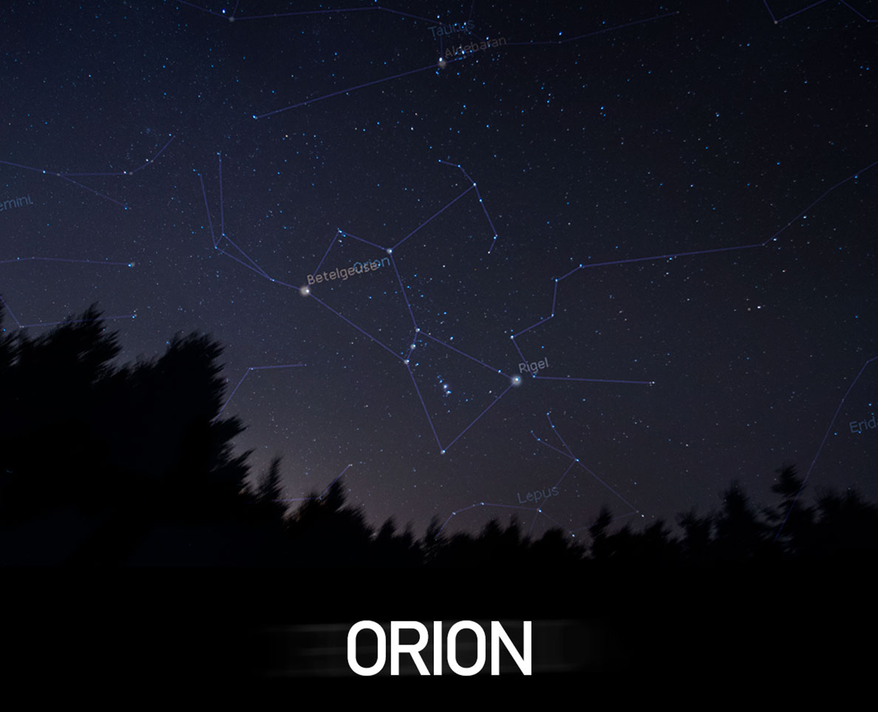
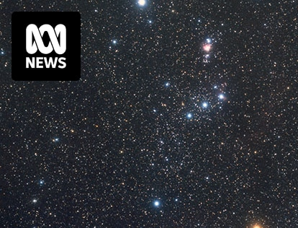
Constellations 12/06/2024
Constellations are group of stars forming a recognisable pattern, that is traditionally named after its apparent form or identified with a mythological figure.

Slide 6
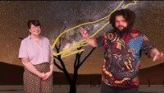

Slide 7
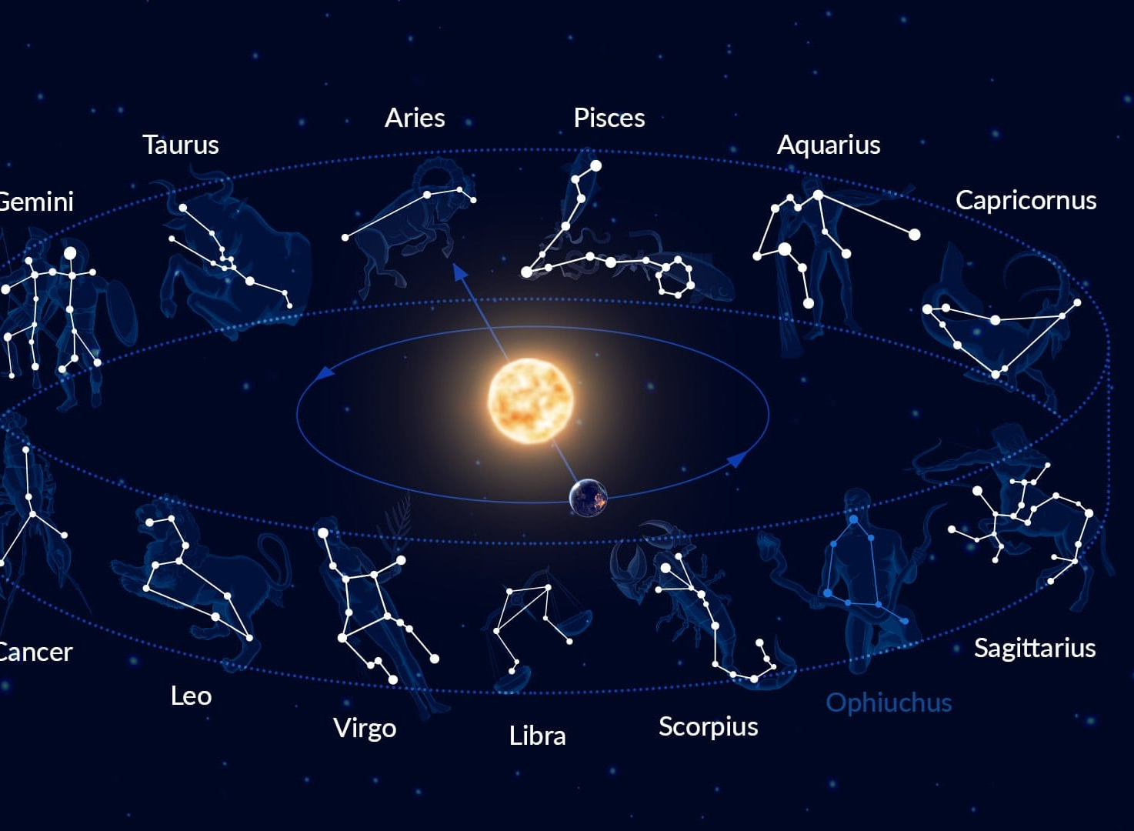
The zodiac
Ancient Greeks saw different constellations move past at different times of the year, this formed the basis of the zodiac or star signs.

Slide 8

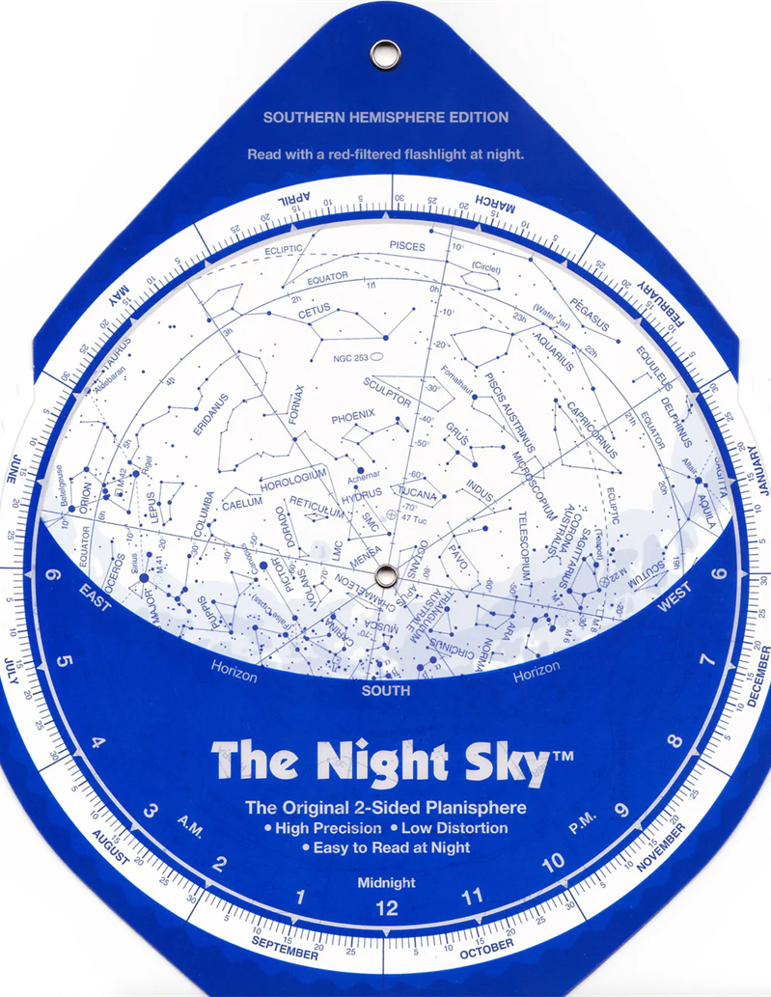
Planisphere
Why do we need to have different planispheres for different locations?
Why do we need to adjust for the different time of year?

Slide 9
Activity: Using sky maps

Slide 10
Success criteria
Identify objects in the night sky
Define and give examples of constellations.
Use a planisphere.

